Slide 1

COVID-19 & Air Quality

Slide 2
COVID19 & Air Quality
This project looks at the air quality index reported by various monitoring stations all over the world as well as reported confirm cases and deaths due to COVID-19 worldwide. We wanted to see if countries with where outbreaks of COVID-19 are forcing more social distancing was leading to better air quality indexes.
We used Python, Pandas, SQLAlchemy, Postgres, Node, and Leaflet
Data Sources:
World Air Quality Index (https://waqi.info/)
World Health Organization CoVid-19 Data

Slide 3
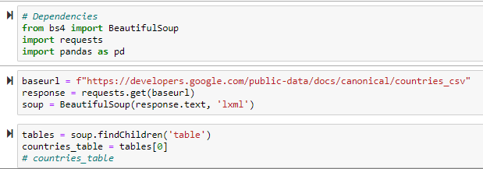
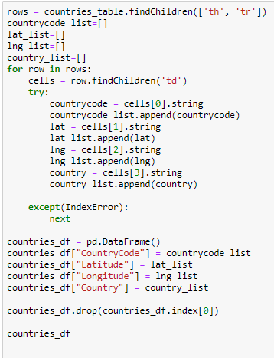
Step 1
We used web scraping to pull COVID-19 data from the World Health Organization.

Slide 4
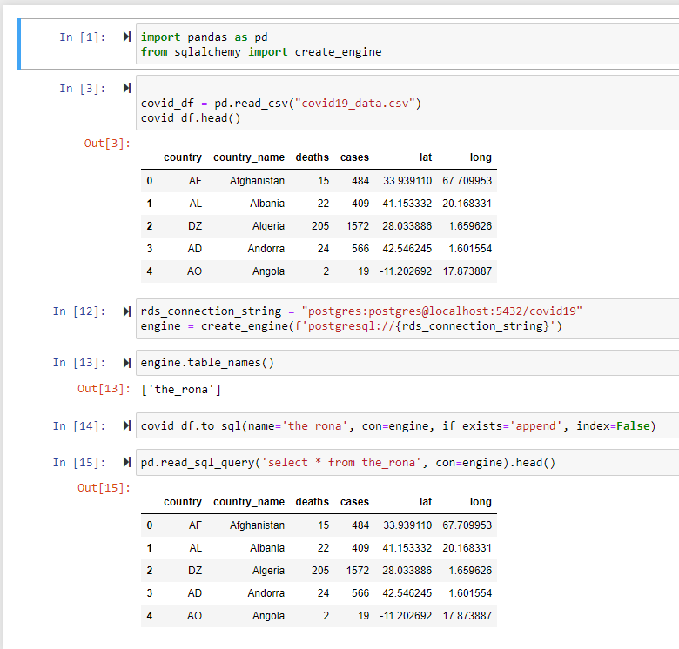
Step 2
We started by reading our csv file with each country’s COVID 19 data into a pandas dataframe and then loading it into Postgres using SQLAlchemy.

Slide 5
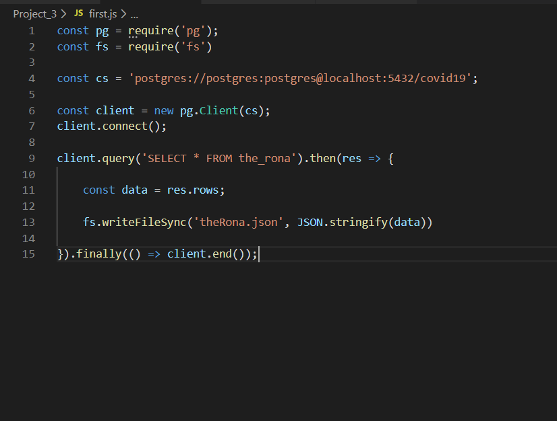
Step 3
Next, we .js to pull the table out of Postgres and save that data as a json file

Slide 6
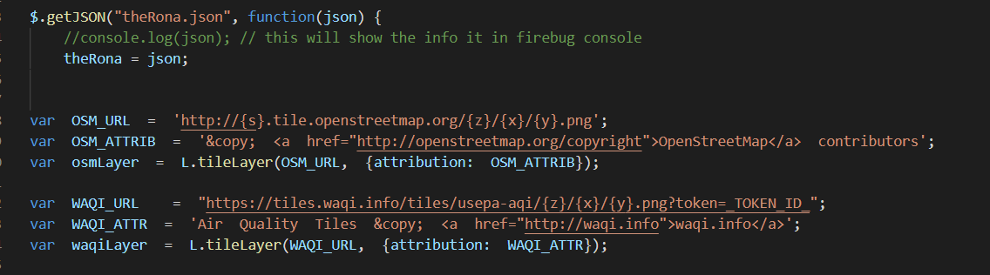
Step 4
Read in json data, set up base map via Open Street Map, utilize World Air Quality Index API to create 1st layer of map: air quality.

Slide 7
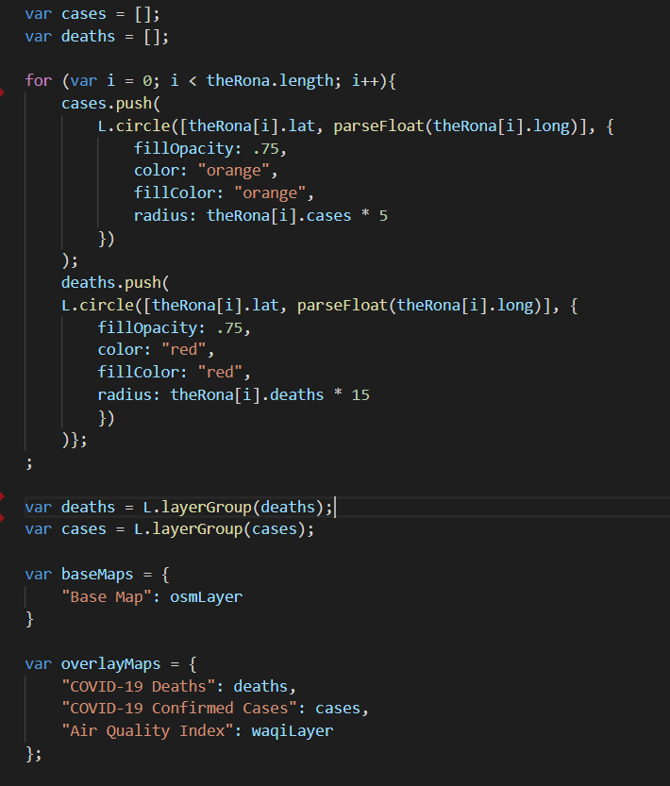
Step 5
Create arrays for both COVID 19 death and cases for each country based on their latitude and longitude. Add layers to map so that we have a layer showing air quality, number of confirmed COVID 19 cases, and number of COVID 19 related deaths.

Slide 8
